Slide 1


By: Rahul Nanduri Internship 32 SME: Shwetank Mishra

Slide 2
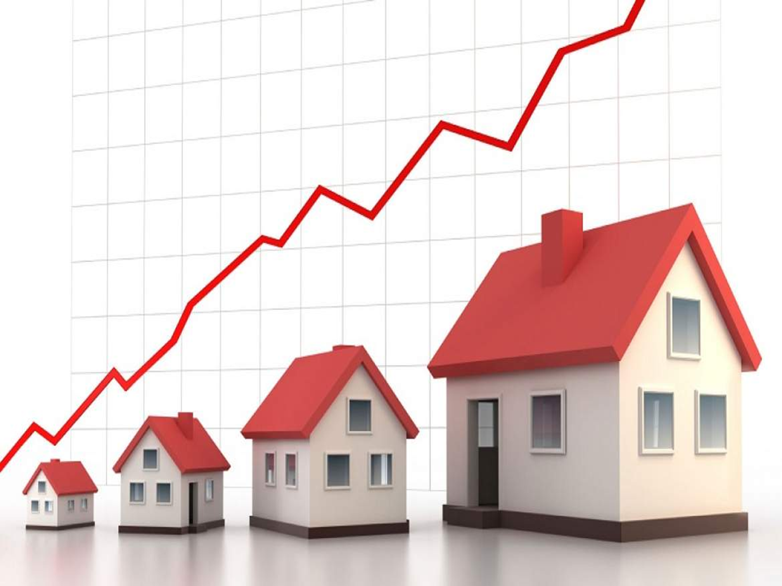
Index
Introduction
Problem Statement
Problem Understanding
Importance and benefits of Housing Price Prediction
Exploratory Data Analysis
Visualizations
Data Analysis Steps
Model Building
Hyper Parameter Tuning
Saving the model and prediction results
Conclusion

Slide 3

Introduction
Thousands of houses are sold every day. There are some questions every buyer asks himself like: What is the actual price that this house deserves? Am I paying a fair price? Also Is it the location? Is it the overall quality of the house? Is it the size? Could it be sold at a good price in future? All these questions come in to our mind when we decide to purchase a house.
In this study, a machine learning model is proposed to predict a house price based on data related to the house (its size, the year it was built in, etc.). During the development and evaluation of our model, we will show the code used for each step followed by its output. This will facilitate the reproducibility of our work.

Slide 4

Problem Statement
A US-based housing company named Surprise Housing has decided to enter the Australian market. The company uses data analytics to purchase houses at a price below their actual values and flip them at a higher price. For the same purpose, the company has collected a data set from the sale of houses in Australia.
The company is looking at prospective properties to buy houses to enter the market. You are required to build a model using Machine Learning in order to predict the actual value of the prospective properties and decide whether to invest in them or not. For this company wants to know:
Which variables are important to predict the price of variable?
How do these variables describe the price of the house?

Slide 5

EDA Steps
Firstly, I have imported the necessary libraries and imported both train and test datasets which were in csv format. And process both datasets simultaneously.
I have done some statistical analysis like checking shape, nunique, column names, data types of the features, info about the features, value counts etc.
I have dropped “Id” and “Utilities” columns from both the datasets. Since they had no significance impact on the prediction.
While looking into the value count function I found some of the columns having more than 85% of zero values so, I dropped those columns from both the datasets as they might create skewness which will impact my model.
I have done some feature extraction as the datasets contained some time variables like YearBuilt, YearRemodAdd, GarageYrBlt and YrSold. Converting them into age seem more meaningful as they offer more information about the longevity of the features. It is analogous to the fact that, the statement “Mr. X died at the age of 66 years” holds more information for us than the statement “Mr. X died in the year 2019”.
So, I have extracted age information from the datetime variables by taking the difference in year between the year the house was built and year the house was sold and dropped the year columns.
I checked the null values and found them in some of the columns. So, I imputed null values present in categorical and numerical columns using mode and mean methods respectively. I found some columns having more than 80% of null values so, I dropped those columns to overcome with the skewness.
All these steps were performed to both train and test datasets simultaneously.
To visualize the data, I have separated categorical and numerical variables based on their types. That is categorical types as Nominal and Ordinal, numerical types as Continuous and Discrete.

Slide 6

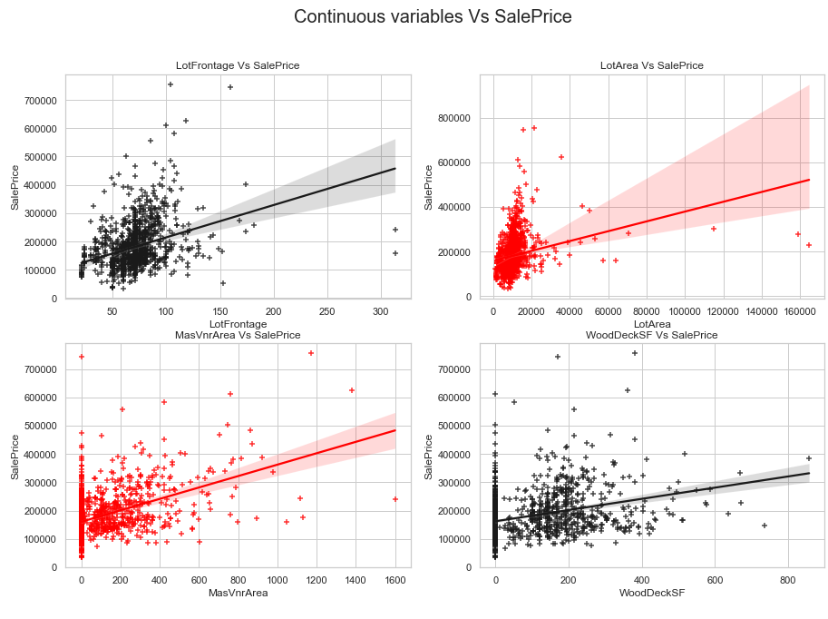
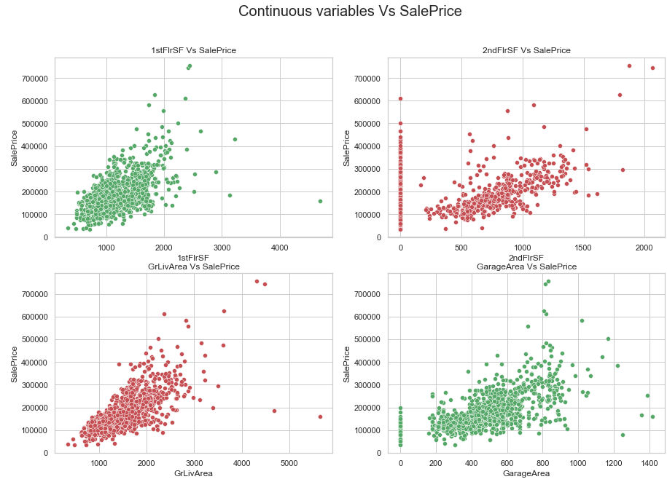
Data Visualization
OBSERVATIONS:
SalePrice vs LotFrontage: From the plot we can observe there is no much linear relation between the label and feature. If the linear feet of street connected to property is more, the sale price is also high.
SalePrice vs LotArea: There is weakly positive linear relation between the label and feature. But the sale price is high when lot size has around 20000 square feet area. Also as the lot size increases the price is also increasing moderately.
SalePrice vs MasVnrArea: There is bit positive linear relation between feature and target. Also the sale price is high when Masonry veneer area has around 50-400 square feet. So as the Masonry veneer area in square feet increases sale price is also increasing.
SalePrice vs WoodDeckSF: There is weakly positive linear relation between the feature and target. As the Wood deck area increases, sale price is also increases.
OBSERVATIONS
SalePrice vs 1stFlrSF: There is a linear relation between the label and feature. As we can observe in the plot, the sale price is high when the first floor area lies between 500-2000 square feet. So as the 1st floor area increases, sales price also increases moderately.
SalePrice vs 2ndFlrSF: There is a positive correlation between SalePrice and 2ndFlrSF. So it is obvious that the sale price increases based on the floors.
SalePrice vs GrLivArea: Most of the houses have above grade living area. There is a positive correlation between the label and feature. Here as the above grade living area increases, sale price also increases.
SalePrice vs GarageArea: Similar to 2nd floor sf, here also positive linear relation between the label and feature. As size of garage area increases, sale price also increases. The sale price is high when size of garage area is between 200-800 square feet.

Slide 7

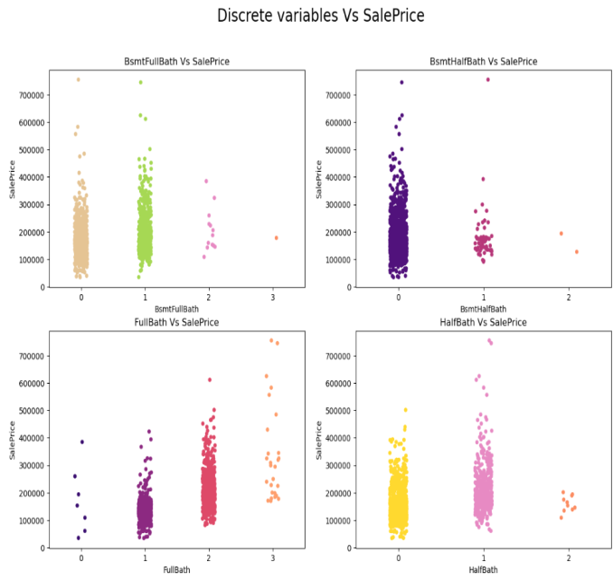
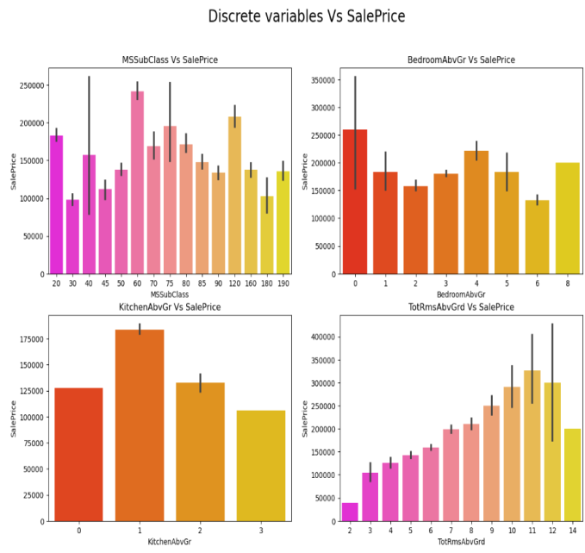
OBSRVATIONS:
SalesPrice vs BsmtFullBath: Most of the houses have basement full bathrooms as 0 and 1 which means some of the houses have single basement bathrooms and some of the houses have no basement bathrooms. And sales price is also high in these cases.
SalesPrice vs BsmtHalfBath: The houses do not have any single basement bathrooms and those houses have average sales price.
SalesPrice vs FullBath: There is positive linear relation between the sale price and full bathrooms above grade. Large number of houses have 1-2 full bathrooms. As the full bathrooms grades increases, sale price is also increasing slightly.
SalesPrice vs HalfBath: Some of the houses have no half bathrooms and also some of the houses have single half bathroom and very few houses have 2 half bathrooms. The houses with 0-1 half bathrooms have average sale price.
OBSERVATIONS:
SalePrice vs MSSubClass: The sale price is high for the MSSubClass 60,120 and 20.
SalePrice vs BedroomAbvGr: Many houses are having 0 and 4 bedrooms have high sales price also houses having 8 bedrooms also have high sales price. Other bedroom grades have average sale price.
SalePrice vs KitchenAbvGr: Most of the houses have single kitchen and few houses have 2 kitchens. The sale price is also high in case of the houses having single kitchen.
SalePrice vs TotRmsAbvGrd: We can observe some linear relation between Total rooms above grade and Sale Prices as the number of rooms increases the sales price also increases

Slide 8

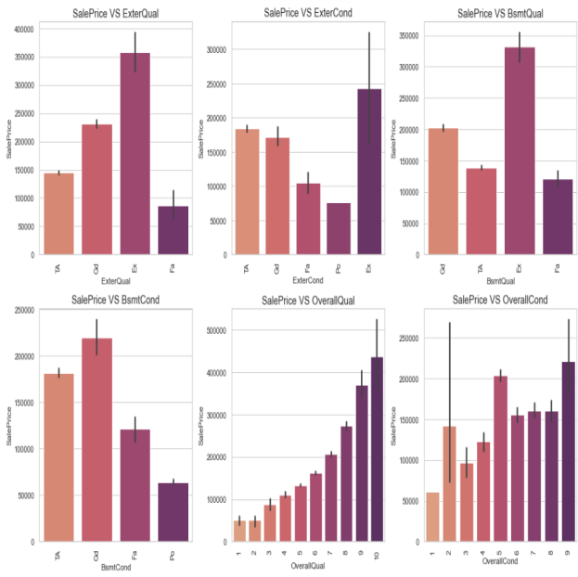
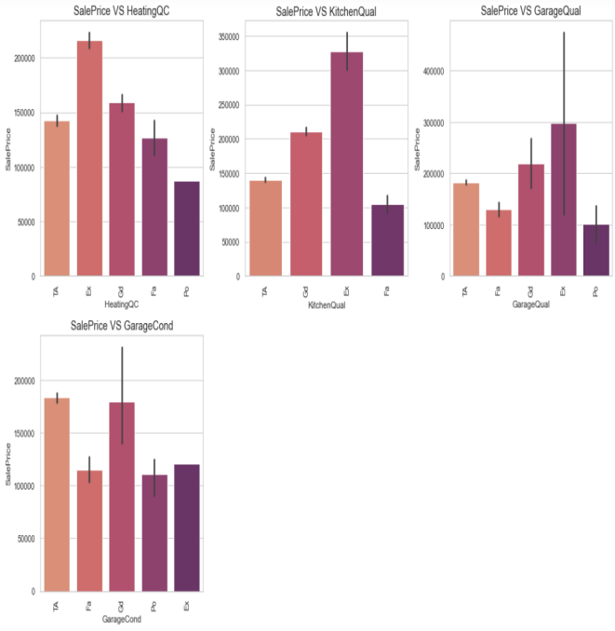
OBSERVATIONS:
SalePrice vs ExterQual: Houses having excellent quality of the material on the exterior have high sale price and houses having fair quality have very less sale price.
SalePrice vs ExterCond: Houses having excellent condition of the material on the exterior have high sale price and the houses having poor condition of the material on the exterior have very less sale price compared to others.
SalePrice vs BsmtQual: The houses which evaluates the excellent quality of height of the basement have high sale price compared to others.
SalePrice vs BsmtCond: The houses which evaluates the good quality of general condition of the basement have high sale price compared to others.
SalePrice vs OverallQual: The houses which have very excellent overall quality like material and finish of the house have high sale price. Also we can observe from the plot as the overall quality of the house increases, the sale price also increases. That is there is good linear relation between SalePrice and OverallQual.
SalePrice vs OverallCond: The houses having overall condition as excellent and average have very high sale price compared to others.
Observations
SalePrice vs HeatingQC: Most of the houses having excellent heating quality and condition have high sale price.
SalePrice vs KitchenQual: Houses having excellent quality of the kitchen have high sale price compared to others.
SalePrice vs GarageQual: The sale price of the house is high for the houses having excellent garage quality.
SalePrice vs GarageCond: Houses having typical/average garage condition have high sale price and the houses having good garage condition also have high sales price compared to others.

Slide 9

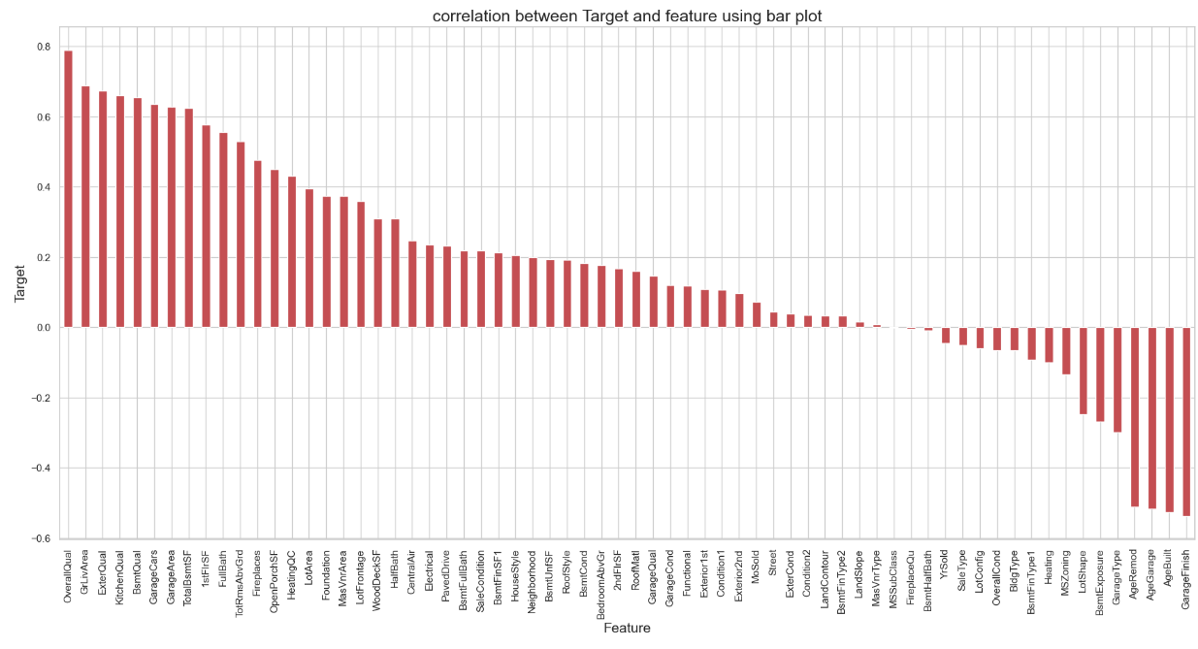
Data Analysis Steps
Correlation Between Features and Label
I have treated null values by imputation techniques.
I have done feature engineering steps like feature extraction and feature selection to improve data normality and linearity.
Identified outliers using boxplots and removed outliers using percentile method.
Identified skewness using distribution plots and removed skewness using power transformation method (yeo-johnson method).
Encoded data using Ordinal Encoder.
Used Pearson’s correlation coefficient to check the correlation between dependent and independent variables. To visualize the correlation I have used heatmap and bar plot.
I have used Standard Scalarization method to scale the data.
Handled the multicollinearity issue by finding VIF values.
Split train and test to build machine learning models. Model building process will be shown in the further steps.
The bar plot shows the important features that affect Sale Price positively and negatively. We can easily notice the correlation here.

Slide 10

Model Building
In this problem SalePrice is our target variable which is continuous in nature, from this I can conclude that it is a regression type problem hence I have used following regression algorithms to predict the sale price of the house.
After the pre-processing and data cleaning I left with 67 columns including target and I used these features for prediction.
Linear Regression
Lasso Regression
Ridge Regression
Random Forest Regression
Extra Trees Regression
Gradient Boosting Regression
Extreme Gradient Boosting Regression (XGB)
Bagging Regression
I have got the best random state and maximum R2 score and then created train test split to build the above models.

Slide 11

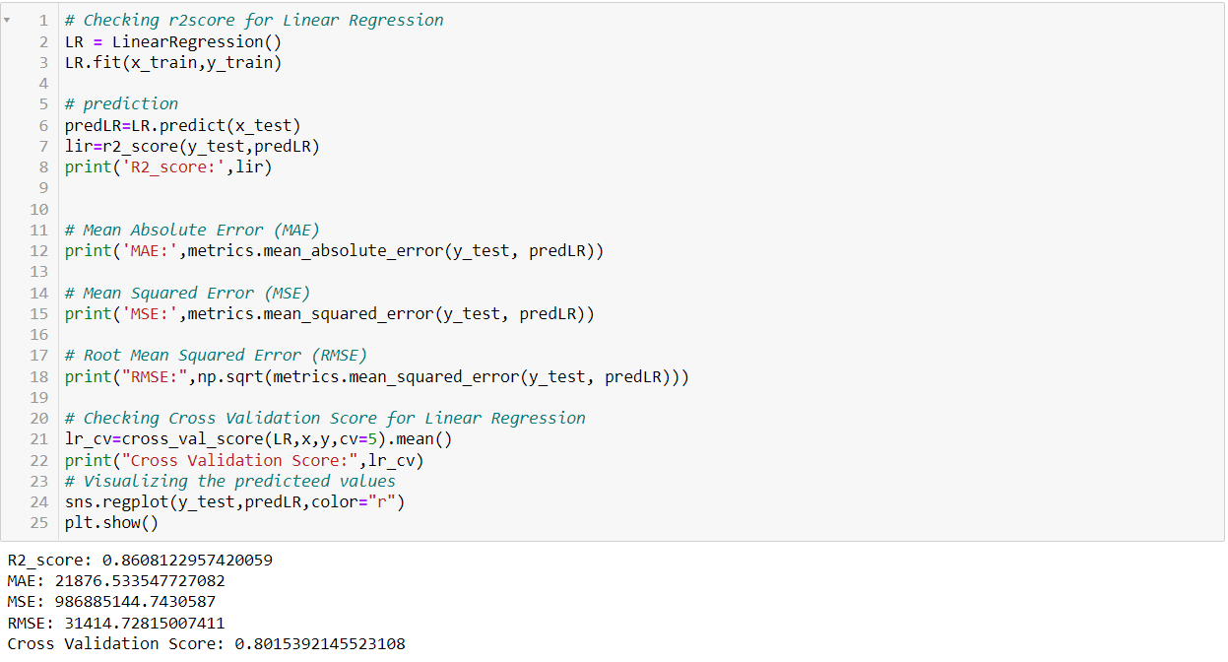
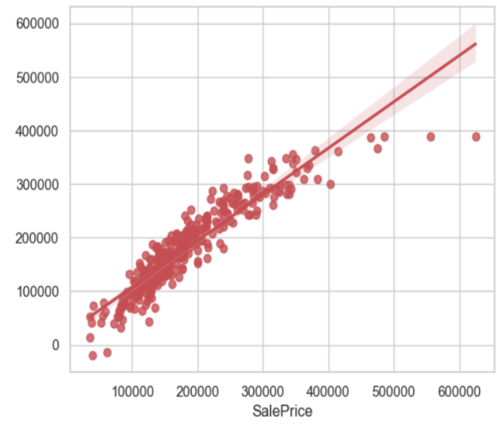
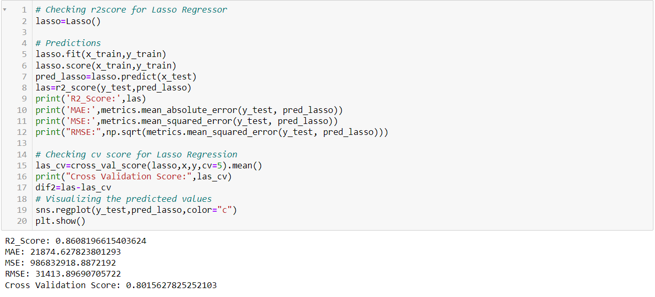
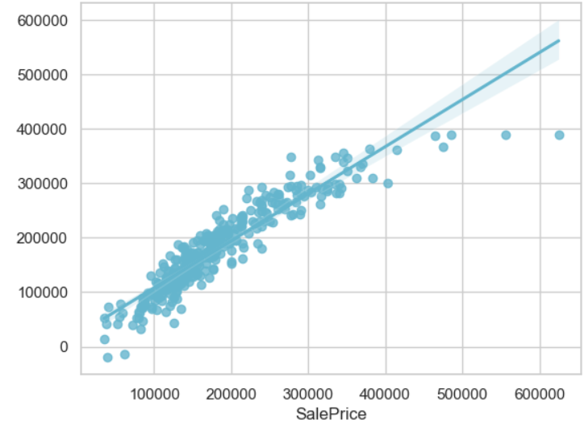
LINEAR REGRESSION:
Created linear regression model and getting 86.08% R2 score using this model. From the reg plot I can observe the sales price of the house. The best fit line shows there is strong linear relation between test data of trained model and predicted values.
Lasso Regressor (Regularization):
Created Lasso regressor model and getting 86.08% R2 score using this model. From the reg plot I can observe the sales price of the house. The best fit line shows there is strong linear relation between test data of trained model and predicted sale price.

Slide 12

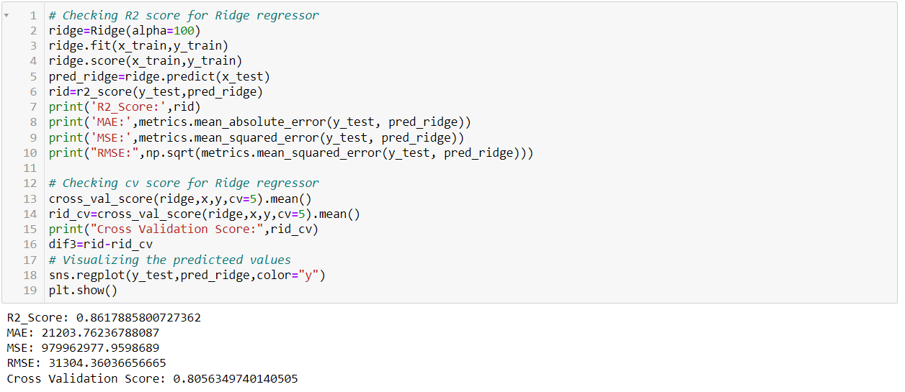
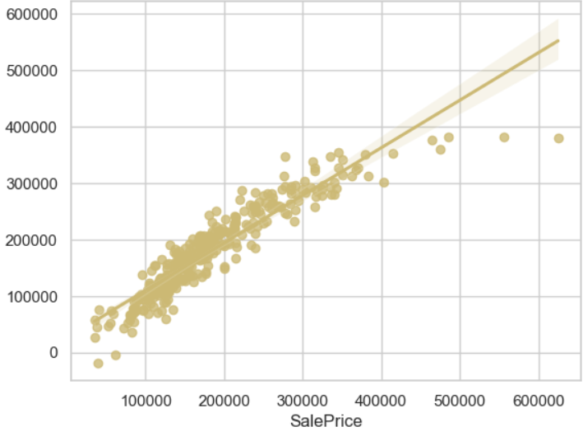
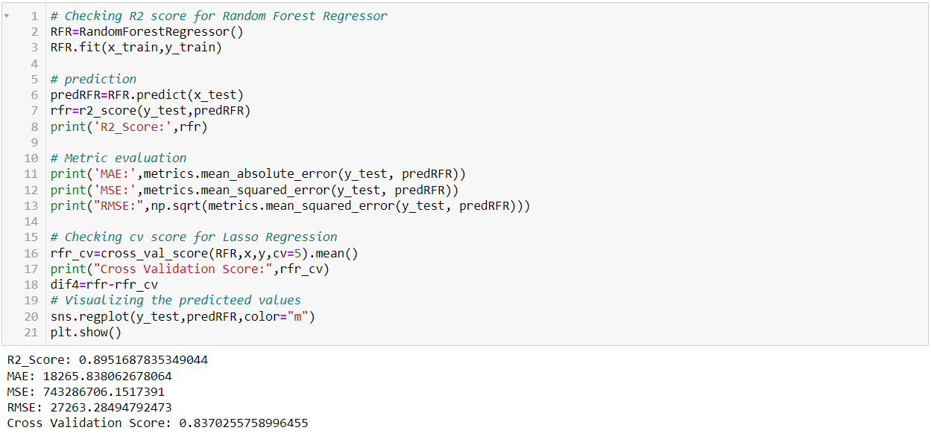
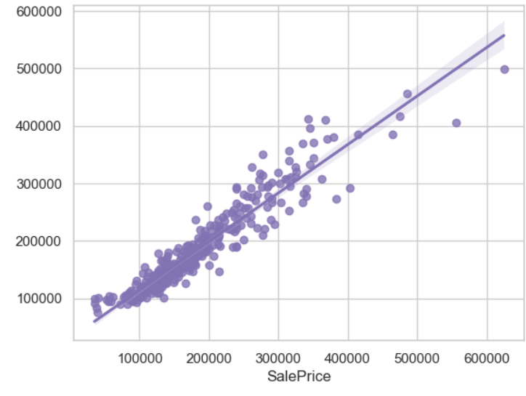
Ridge Regressor (Regularization)
I have got alpha value as 100 using this I have created Ridge regressor model and getting 86.17% R2 score using this model. From the plot I can observe the sales price of the house. The best fit line shows there is strong linear relation between test data of trained model and predicted sale price.
Random Forest Regressor
Created Random Forest Regressor model and getting 89.51% R2 score using this model.

Slide 13

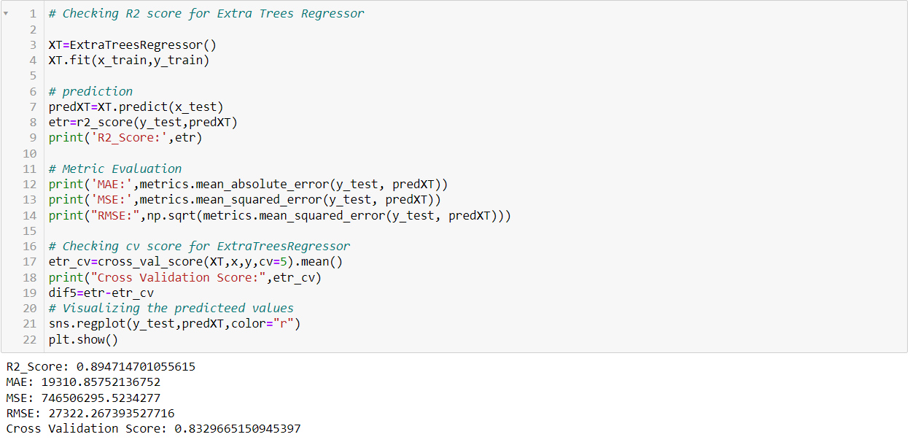
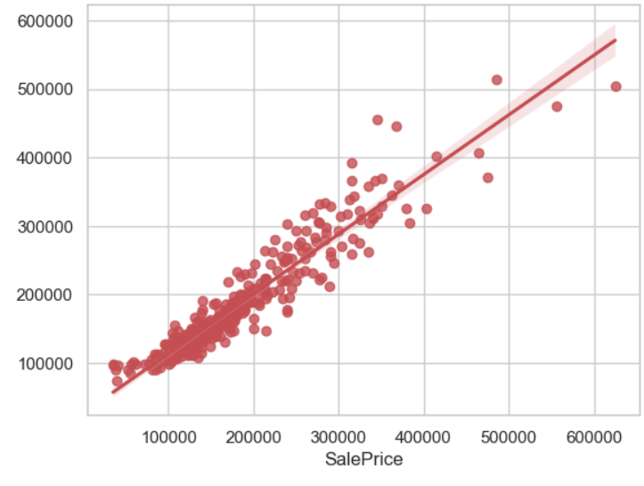
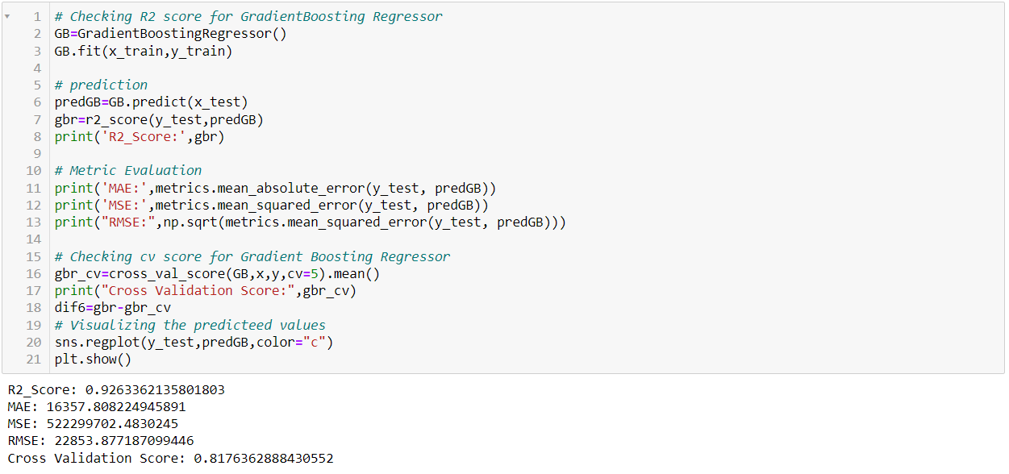
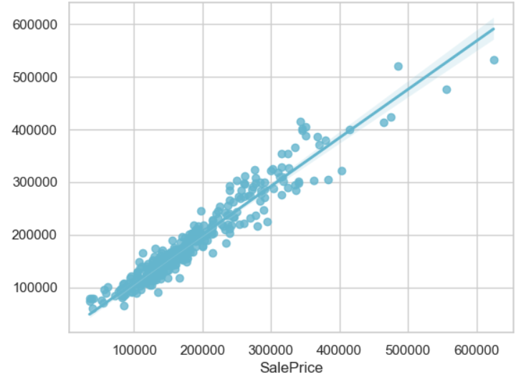
Extra Trees Regressor
I have created Extra Trees Regressor model and getting 89.47% R2 score using this model.
Gradient Boosting Regressor
Created Gradient Boosting Regressor model and getting 92.63% R2 score using this model

Slide 14

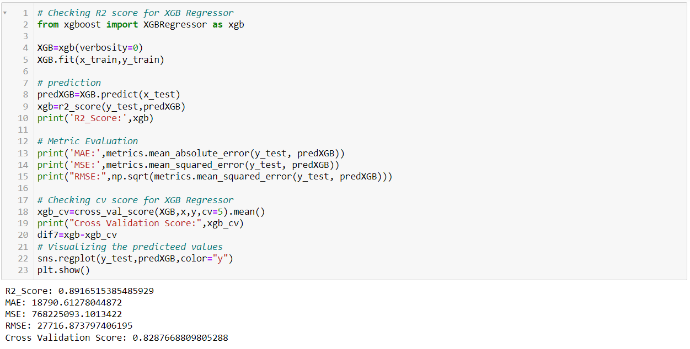
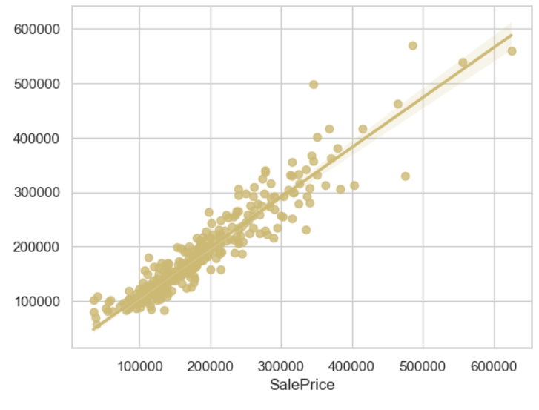
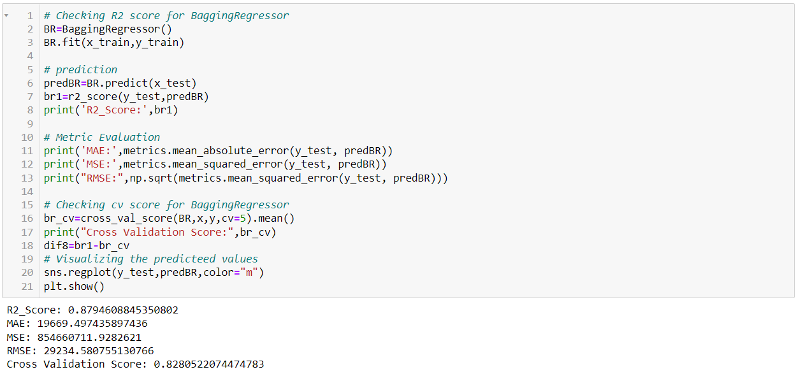
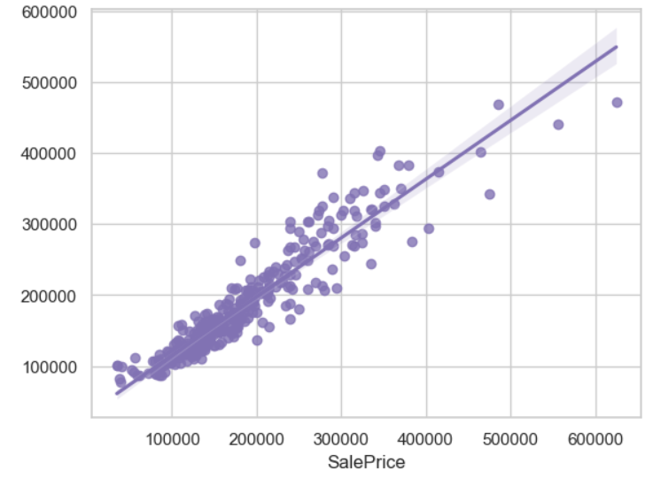
Extreme Gradient Boosting Regressor
Created Extreme Gradient Boosting Regressor model and getting 89.16% R2 score using this model.
Bagging Regressor
Created Bagging Regressor model and getting 87.94% R2 score using this model.

Slide 15

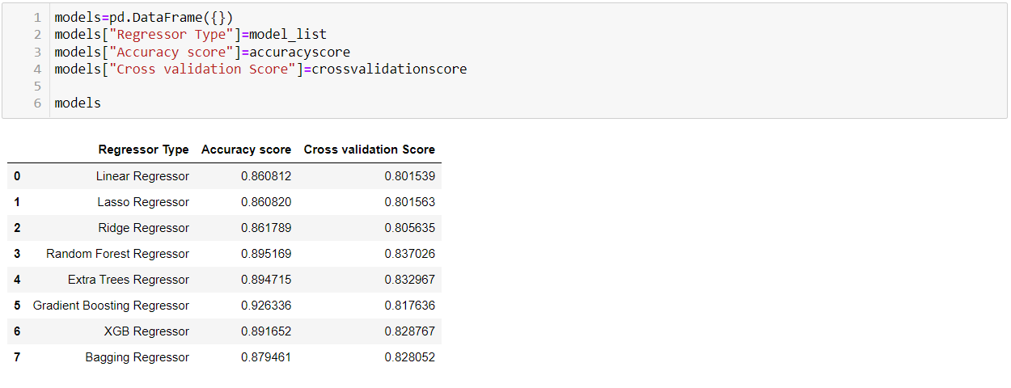
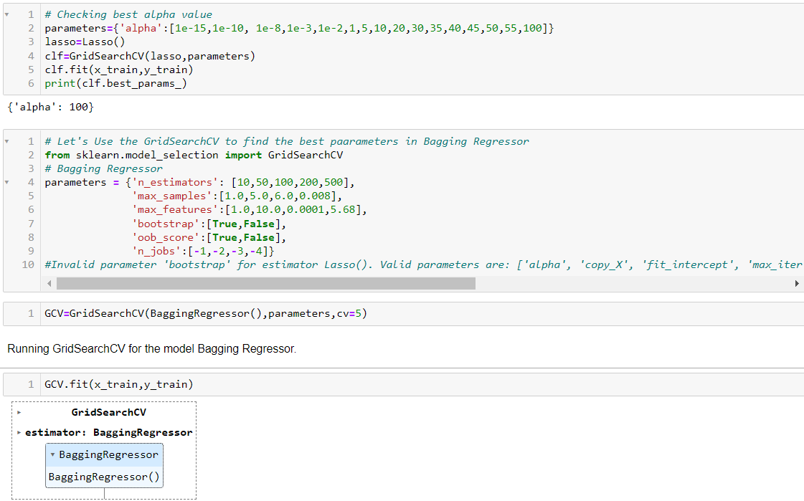
Model Selection
From the difference between R2 score and Cross Validation score I can conclude that Lasso Regressor as my best fitting model as it is giving less difference compare to other models. Let's perform Hyperparameter tuning to increase the model accuracy.
Hyper Parameter Tuning
I have used GridSearchCV to get the best parameters of Bagging Regressor. And used all the obtained parameters to get the accuracy of final model.

Slide 16

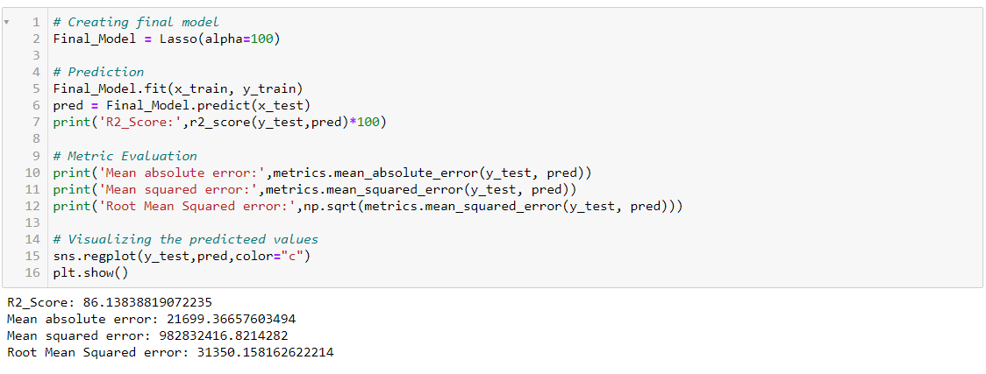
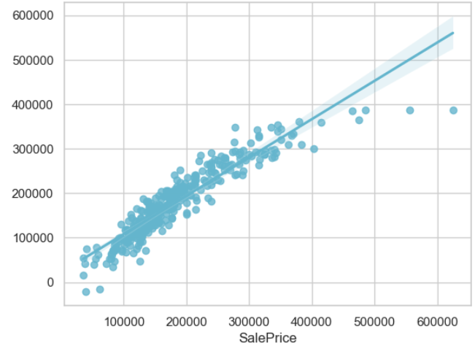
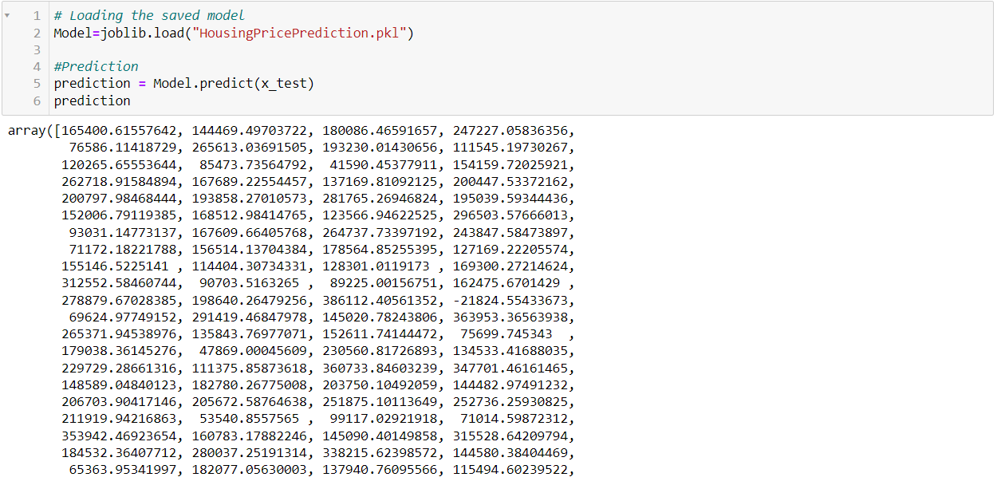
Creating Final Model After Tuning
The R2 score of Bagging Regressor has been increased after tuning the model. It is giving R2 score as 86.13% which is very good. The plot gives some strong linear relation between test and predicted values. Also, I can notice the MAE, MSE and RMSE values have been reduced. Which means that our model trained well.
Saving the final model and predicting the sale price for test data
I have saved my final best model using joblib library in .pkl format, and loaded saved model for predictions.
I have predicted the SalePrice for test dataset using saved model of trained dataset and getting good predictions. I have saved my predictions in csv format for further analysis.

Slide 17


Conclusion
In this study, we have used multiple machine learning models to predict the house sale price. We have gone through the data analysis by performing feature engineering, finding the relation between features and label through visualizations. And got the important feature and we used these features as inputs to predict the price by building ML models.
We have got good prediction results. After using hyper parameter tuning, the best model value increased and the R2 score was good, also the errors decreased which means no over-fitting issue. And predicted the sale price for test data using saved best model.
Finally, our aim is achieved by predicting the house price for the test data, I hope this will be further helps for sellers and buyers to understand the house marketing. The machine learning models and data analytic techniques will have an important role to play in this type of problems. It helps the customers to know the future price of the houses.
As a recommendation, I advise to use this model by the people who want to buy a house in the area covered by the dataset to have an idea about the actual price. The model can be used also with datasets that cover different cities and areas provided that they contain the same features. I also suggest that people should take into consideration the features that were deemed as most important as seen in this study which might help them estimate the house price better.

